Slide 1
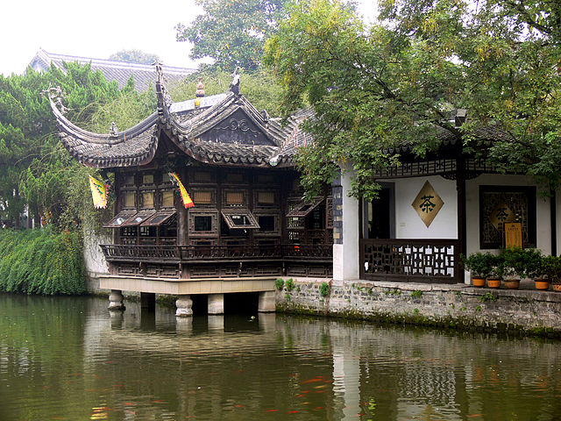
Who is testing the mocks?
an assume-verify-approach
Andreas Leidig, Robin Danzinger

Slide 2
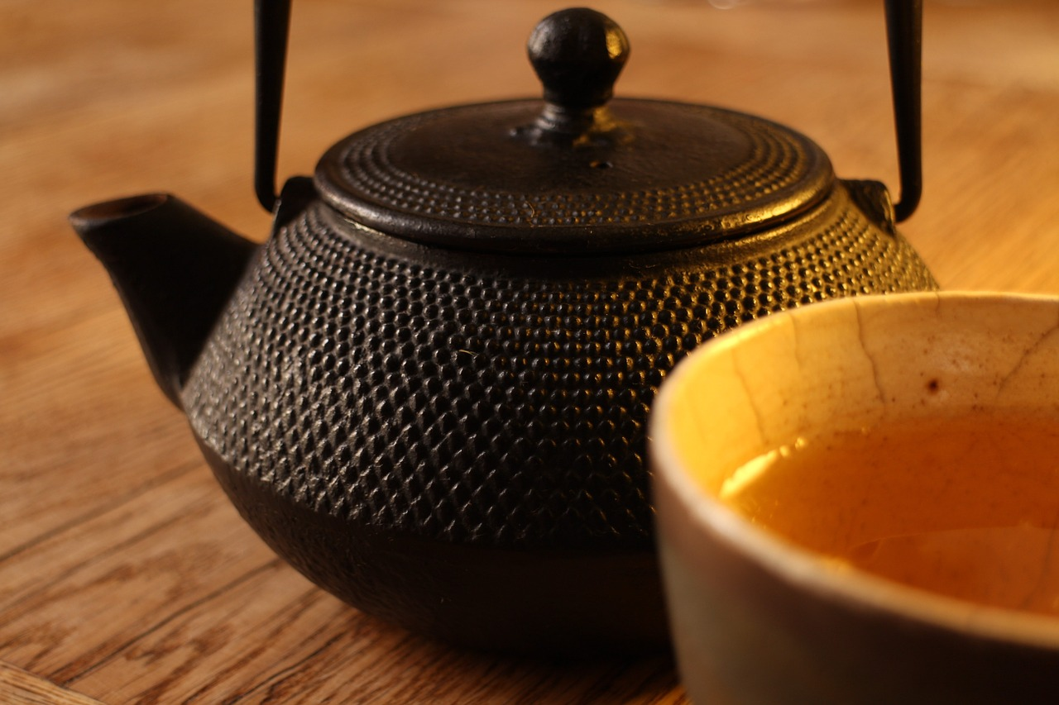
agenda
Motivation
Idiosyncrasies of Javascript
Test Doubles
Assume-Verify-Approach
Chadojs
Discussion

Slide 3

Motivation
Test approach
London School
Integrated Tests
Unit Tests
Idiosyncrasies of Javascript
Dynamic
Prototype
Simple

Slide 4

Integrated Tests are a Scam (2010)
http://blog.thecodewhisperer.com/blog/categories/integrated-tests-are-a-scam

Slide 5
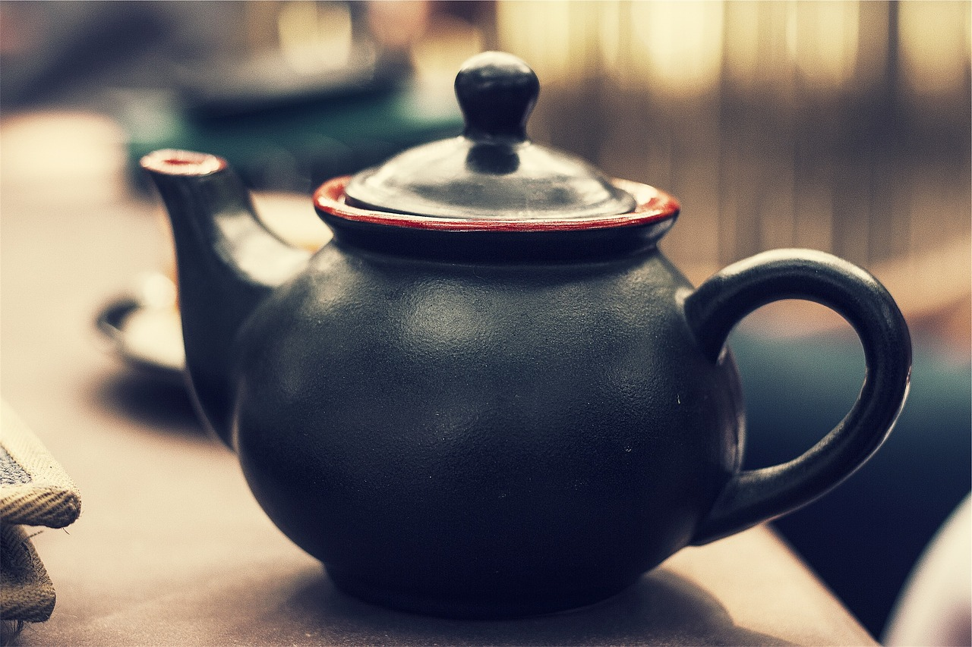
Integrated Tests are a Scam (2010)
Integrated tests
are not the same as
integration tests

Slide 6
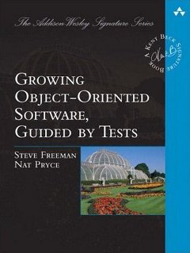
Outside-In „London School“ (2009)
http://www.growing-object-oriented-software.com

Slide 7
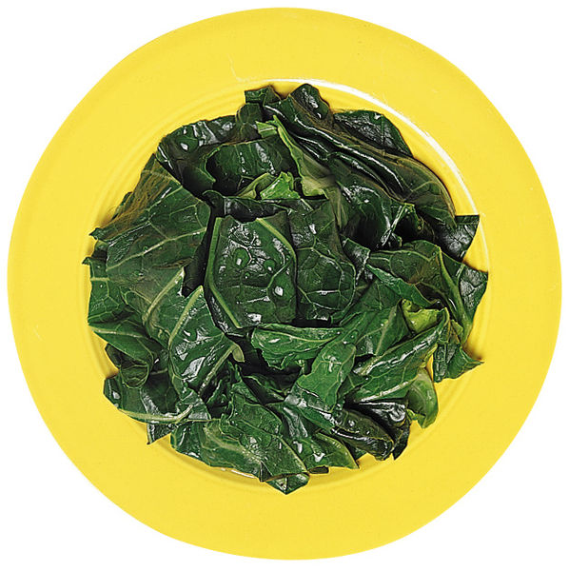
Idiosyncrasies of Javascript
Mititei
is much more wholesome,
if you replace it right before serving
with spinach.

Slide 8
Idiosyncrasies of Javascript
dynamic language
create objects on the fly
change objects on the fly
functions are first class objects
very powerful, but can be very error-prone!

Slide 9
Idiosyncrasies of Javascript
code example

Slide 10
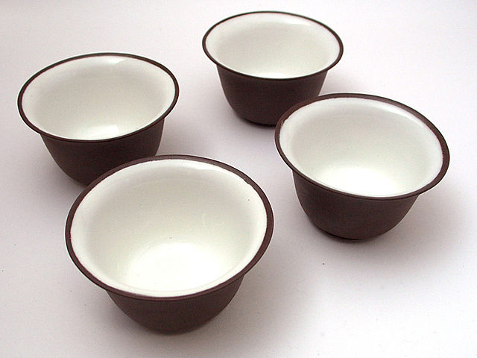
Back to now
we don‘t want integrated tests
but integration tests
we like London School
many isolated tests
„heavy mocking“

Slide 11
agenda
Motivation
Idiosyncrasies of Javascript
Test Doubles
Assume-Verify-Approach
Chadojs
Discussion

Slide 12
Test Doubles
spy, stub, mock, dummy
in everyday use often no precise distinction
How do you use test doubles?

Slide 13

Test Doubles
test
assumption 1
„menu no. 42“
waiter
mocked
chef
assumption 2

Slide 14
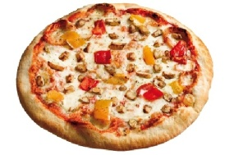
Test Doubles
test
„menu no. 42“
mocked
chef
real app
„menu 42“
real
chef

Slide 15
Test Doubles
test
„menu 42“
mocked
chef
real app
„menu 42“
real
chef

Slide 16
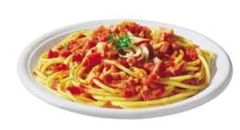
Test Doubles
test
„menu 42“
mocked
chef
unit-tests with mocks
could be mocks itself.
real app
„menu 42“
real
chef

Slide 17
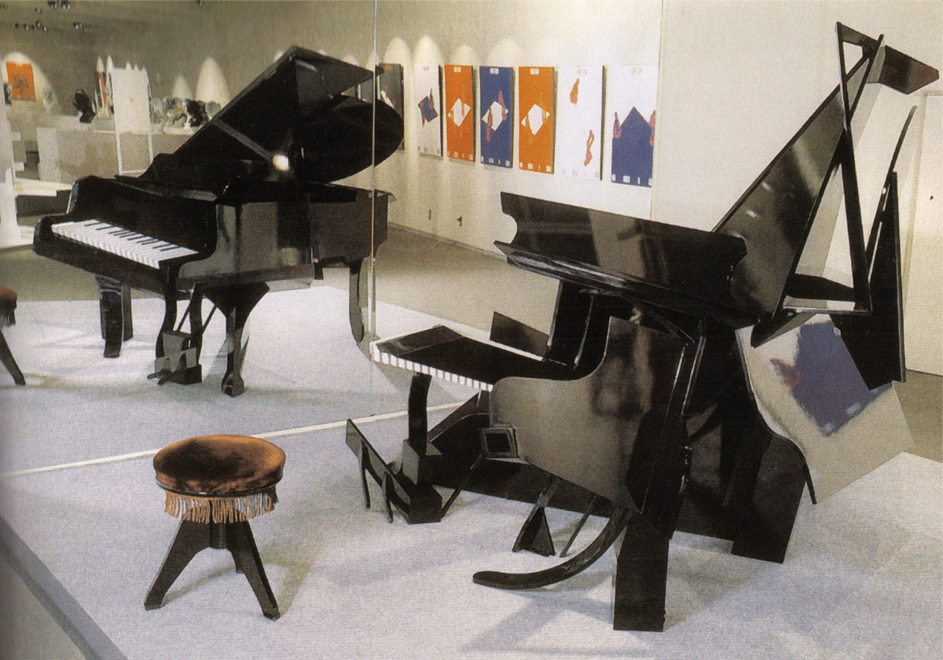
to mock = to mimic
to mock = to delude

Slide 18
If we want to test with mocks successfully we have to ensure that our mocks work under realistic assumptions
Are the assumptions correct?
Does the real object behave as we assume?

Slide 19
agenda
Motivation
Idiosyncrasies of Javascript
Test Doubles
Assume-Verify-Approach
Chadojs
Discussion

Slide 20
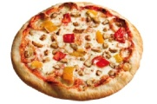
Assume-Verify-Approach
testdouble
waiter
„menu 42“
test
waiter
Assume
chef
„menu 42“
test
chef
Verify

Slide 21
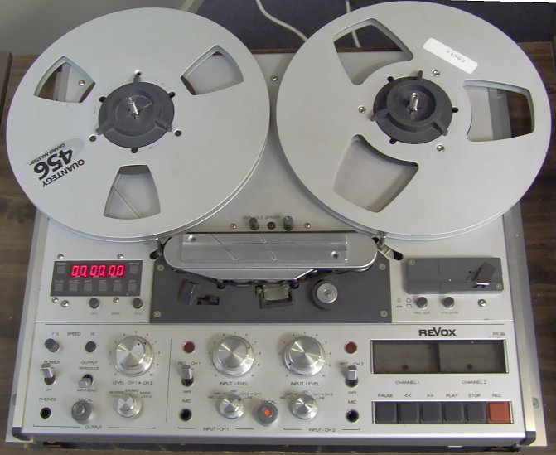
Assume-Verify-Approach
Record all assumptions and verifications
Test
Assume
Test
Assume
Test
Assume
Verify
…
Assume
Verify
Test
…

Slide 22
Assume-Verify-Approach
Match all assumptions and verifications
Does for every assumption exist at least one verification?
Does for every verification exist at least one assumption?
Assume
Verify
Assume
Assume
Verify
Assume
Assume
Assume
Verify
Verify
Assume
Verify
Verify
Assume
Assume

Slide 23
agenda
Motivation
Idiosyncrasies of Javascript
Test Doubles
Assume-Verify-Approach
Chadojs
Discussion

Slide 24
code example

Slide 25
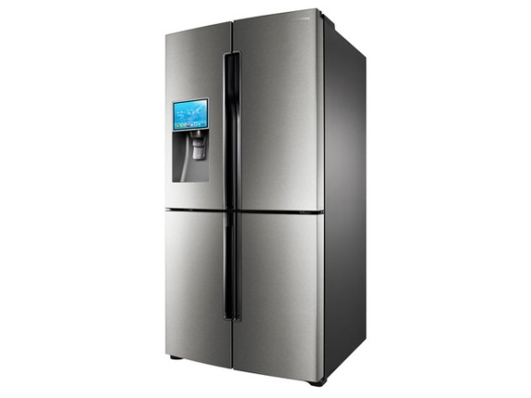
Restaurant simulation
I order a menu
I take the order
I fetch the ingredients and cook
client
waiter
chef
pantry

Slide 26
Restaurant simulation
I order a menu
I take the order
I fetch the ingredients and cook
„pizza tonno“
„142“
„ingredients“
pizza tonno
pizza tonno
ingredients
client
waiter
chef
pantry

Slide 27
code example

Slide 28
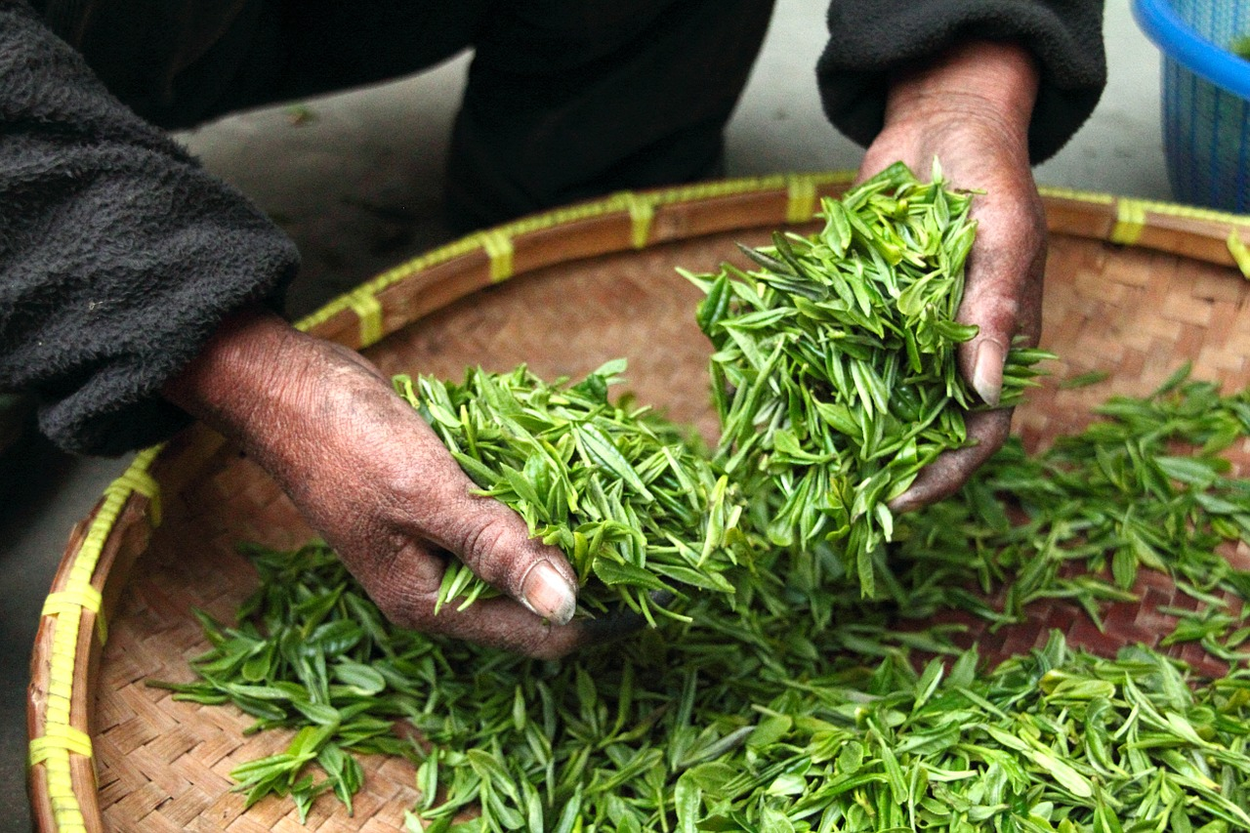
Summary
high coverage by isolated tests
interaction of units should be tested too
pairwise integration
assume-verify testing with chado

Slide 29


Slide 30
Links
Chadojs on Github: https://github.com/robindanzinger/chadojs
J.B.Rainsberger: Integrated tests are a scam: http://blog.thecodewhisperer.com/blog/categories/integrated-tests-are-a-scam
bogus for ruby: https://github.com/psyho/bogus
midje for clojure: https://github.com/marick/Midje

Slide 31
Sources
https://pixabay.com/de/teekanne-trinken-pokal-getr%C3%A4nke-516024/
https://pixabay.com/de/fr%C3%BChling-hintergrund-gr%C3%BCn-gras-315247/
https://pixabay.com/de/tee-bauernhaus-hand-frisch-623796/

Slide 32
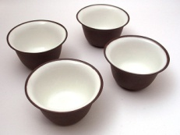


Sources
„Chapei“ von Original uploader was Commonsenses at ja.wikipedia - Originally from ja.wikipedia; description page is/was here.. Lizenziert unter CC BY-SA 3.0 über Wikimedia Commons - https://commons.wikimedia.org/wiki/File:Chapei.jpg#/media/File:Chapei.jpg
„Monk in Tashilhunpo3“ von Antoine Taveneaux - Eigenes Werk. Lizenziert unter CC BY-SA 3.0 über Wikimedia Commons - https://commons.wikimedia.org/wiki/File:Monk_in_Tashilhunpo3.jpg#/media/File:Monk_in_Tashilhunpo3.jpg
„Teahouse-Nanjing“ von Gisling - Eigenes Werk. Lizenziert unter CC BY 3.0 über Wikimedia Commons - https://commons.wikimedia.org/wiki/File:Teahouse-Nanjing.jpg#/media/File:Teahouse-Nanjing.jpg

Slide 33
Sources
https://pixabay.com/get/ef3cb0082afd1c22d2524518a33219c8b66ae3d11fb2134590f3c279/teapot-691729_1280.jpg
„Revox-reel-to-reel“ von User Iain from en:Wikipedia, 06:55, 16 June 2006 (UTC) - My Original Photo. Lizenziert unter Gemeinfrei über Wikimedia Commons - https://commons.wikimedia.org/wiki/File:Revox-reel-to-reel.JPG#/media/File:Revox-reel-to-reel.JPG
„Optische illusion piano“ von ​German Wikipedia Benutzer Roger. Lizenziert unter GFDL über Wikimedia Commons - https://commons.wikimedia.org/wiki/File:Optische_illusion_piano.jpg#/media/File:Optische_illusion_piano.jpg

